Slide 1
This project is based on Selenium Automation .
Project Name : Automation using selenium python
Creator : Sujoy Kayet
Roll No : 16971021012

Slide 2
Table Contains :
Introduction of selenium
History of Selenium
Need of Automation technology
Features & Advantages of Selenium
Limitations of Selenium
Future Scope
About Project

Slide 3
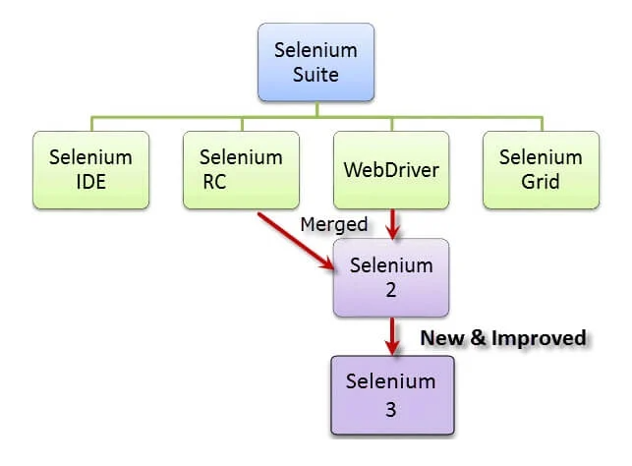
Introduction of selenium :
Selenium is a free (open-source) automated testing framework used to validate web applications across different browsers and platforms. You can use multiple programming languages like Java, C#, Python, etc. To create Selenium Test Scripts. Testing done using the Selenium testing tool is usually referred to as Selenium Testing.
Selenium has been in the market for over a decade and has proven to be a robust tool for automation testing. Developed by Jason Huggins, its main objective was to overcome the limitations of manual testing.
Current version Selenium 3.

Slide 4
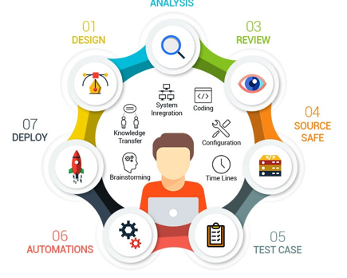
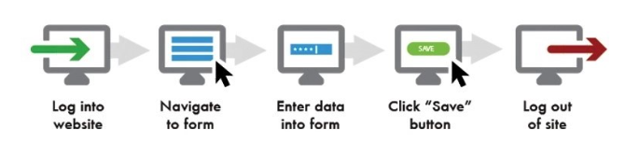
Advantages of Selenium :
All will happen automatically
Reduce manual effort
Save a lot of time
Increase perfection
Reduce scope of mistakes
Increase code reusability

Slide 5
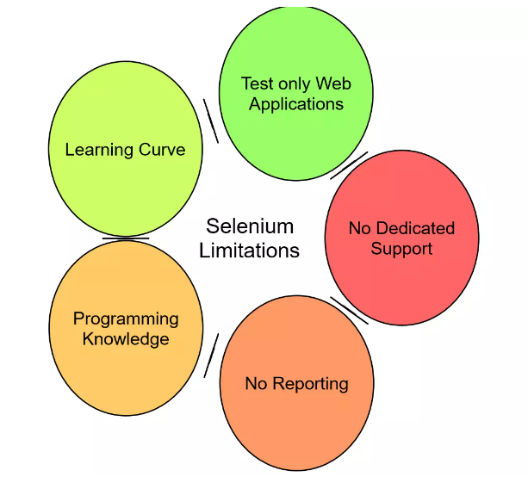
Disadvantages of Selenium :
Supports only a single browser
Does not provide any test management tool
Lacks built-in reporting feature
Lacks some of the advanced latest features

Slide 6
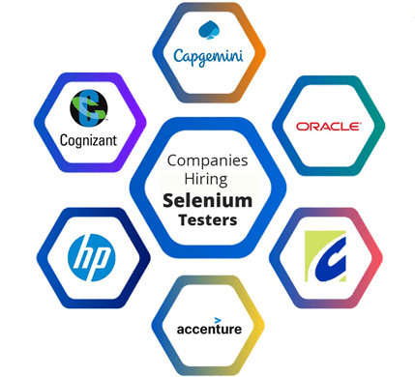
Future Scope :
Automation testing is an innovative field and, in a software development process, the development and the testing fields are ever in need of talented testers who can help with easy releases of new versions and the maintenance of the software. As there are various benefits that Selenium brings to the table, it is a widely chosen tool, tempting us to think of making a career in Selenium Testing.
Major Companies Hiring Selenium Testers.
As there will be a continuous demand for software for various objectives in most companies and as no software has ever been produced without bugs, indulging with this open-source and easy-to-use tool will ensure us a fruitful career. There are a plethora of MNCs that rely on Selenium and use it extensively for testing purposes such as Facebook, and Microsoft. Cognizant, HP, Accenture, etc. They employ Selenium Testers with deep knowledge and Selenium certification.

Slide 7
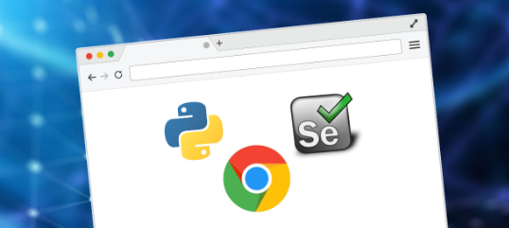


About Project :
Tools Used :
Selenium
Python
Chrome Browser
Chrome Web Driver
Excel
Visual Studio Code Editor
Orange Hrm Open source Web site

Slide 8
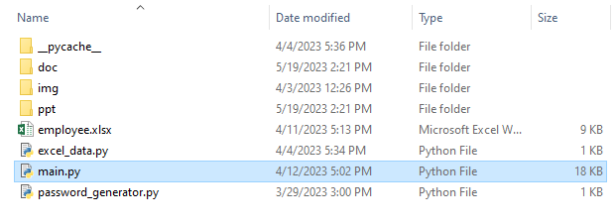
Project structure :

Slide 9
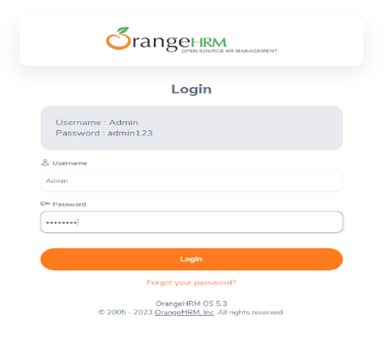
How this project works :
Data will fetch from excel each row have data of individuals –
You just need to run the main.py file and that’s it according the data all online forms will be filled automatically –
Login with proper user id & password

Slide 10
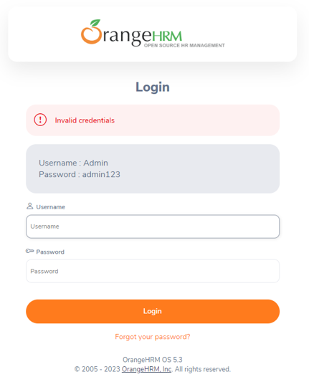
Check the id & password is correct or not :

Slide 11
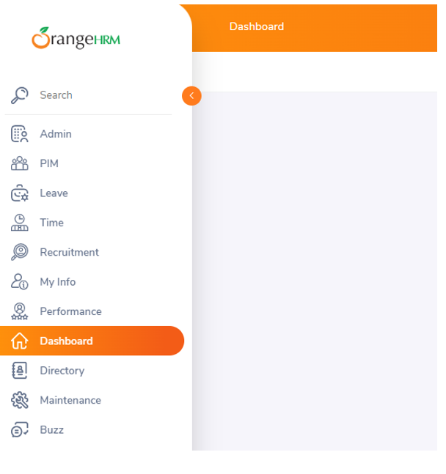
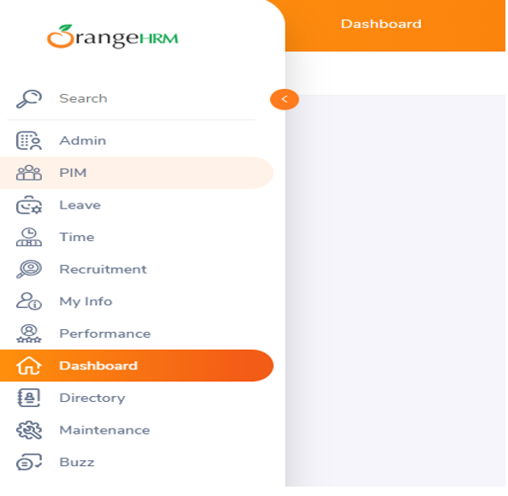
Navigate to the form page :
Check dashboard page is opened or not
Go to PIM section

Slide 12
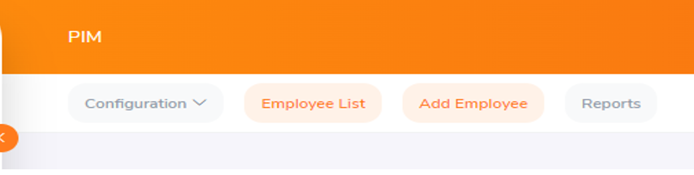
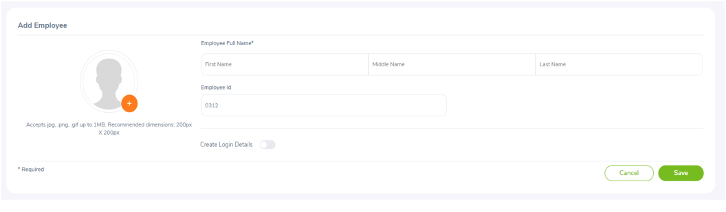
Select Add Employee –
Provide Information according the excel data -

Slide 13
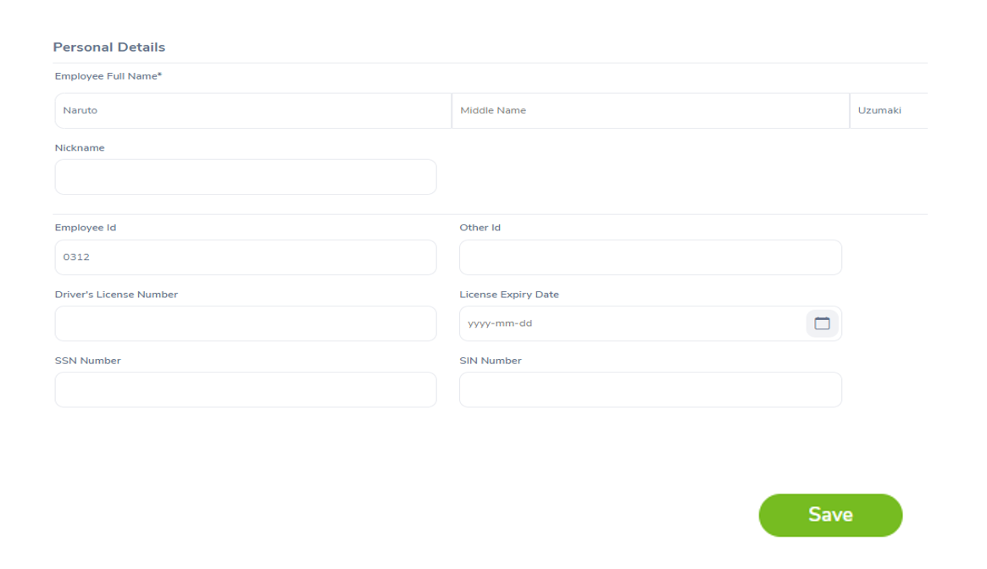
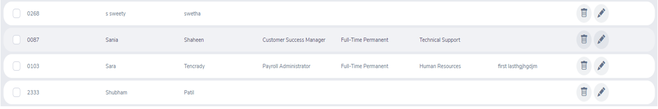
Fill the Personal details –
Show recent data in the database

Slide 14


